Slide 1
R and data introduction III
Chi Zhang
21/05/2014

Slide 2
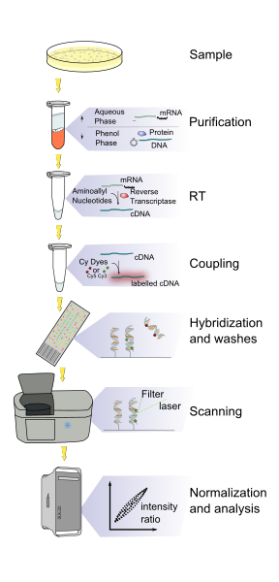
Microarray data
Intensity
Not sensitive to transcripts with low abundance
Hybirdization
Probe design!.

Slide 3
Using microarray data, you should know:
Organism
Experimental design
Sample list (Sample distribution, sample size)
Platform
Important!!!!

Slide 4
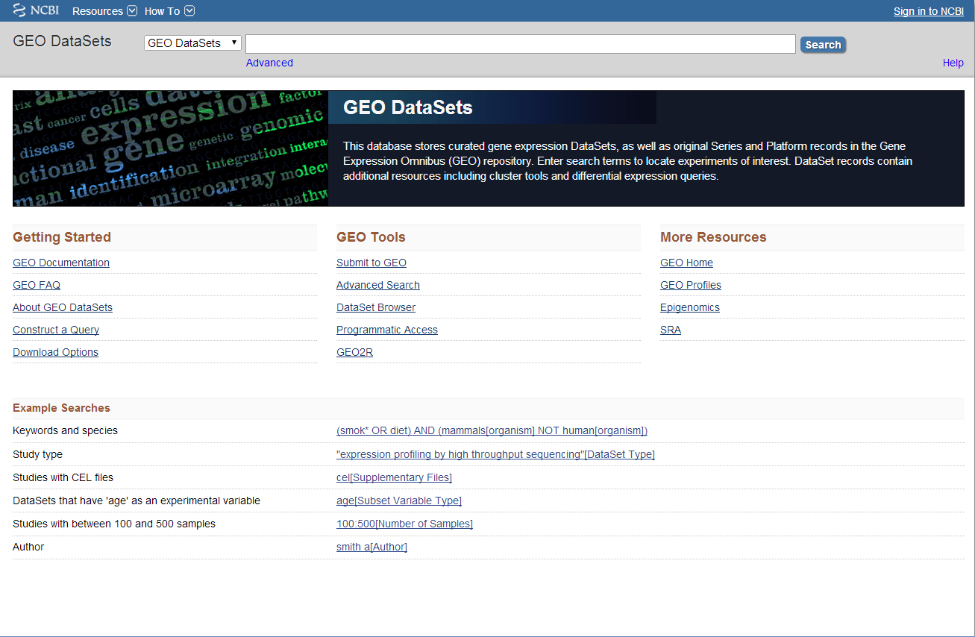
Microarray data
Geo data base
http://www.ncbi.nlm.nih.gov/gds/

Slide 5
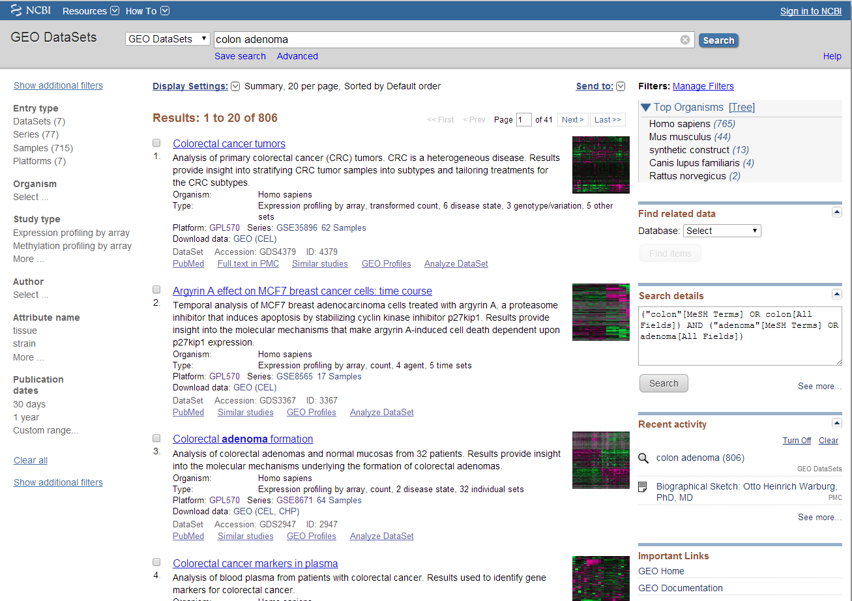
Step 1: Key words

Slide 6
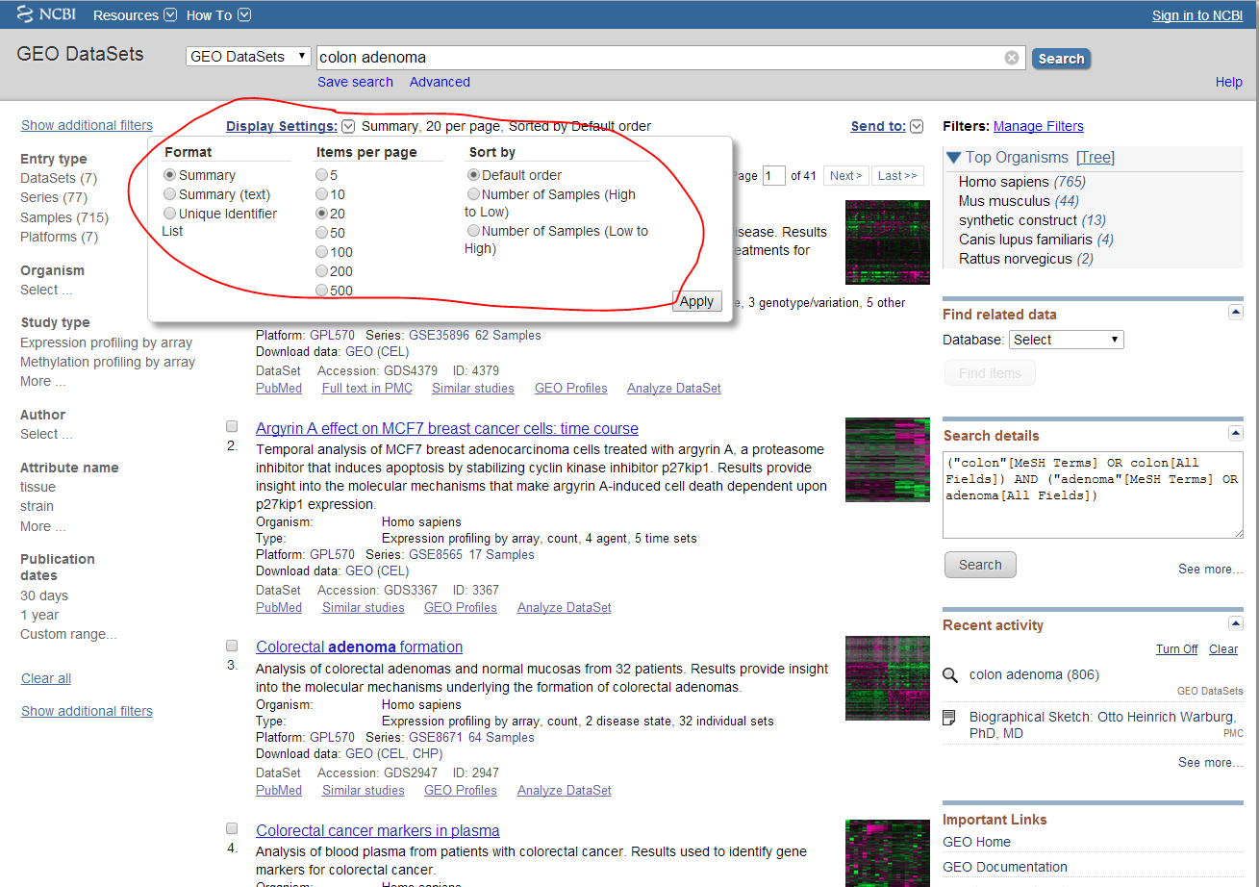
Step 2: Select data

Slide 7
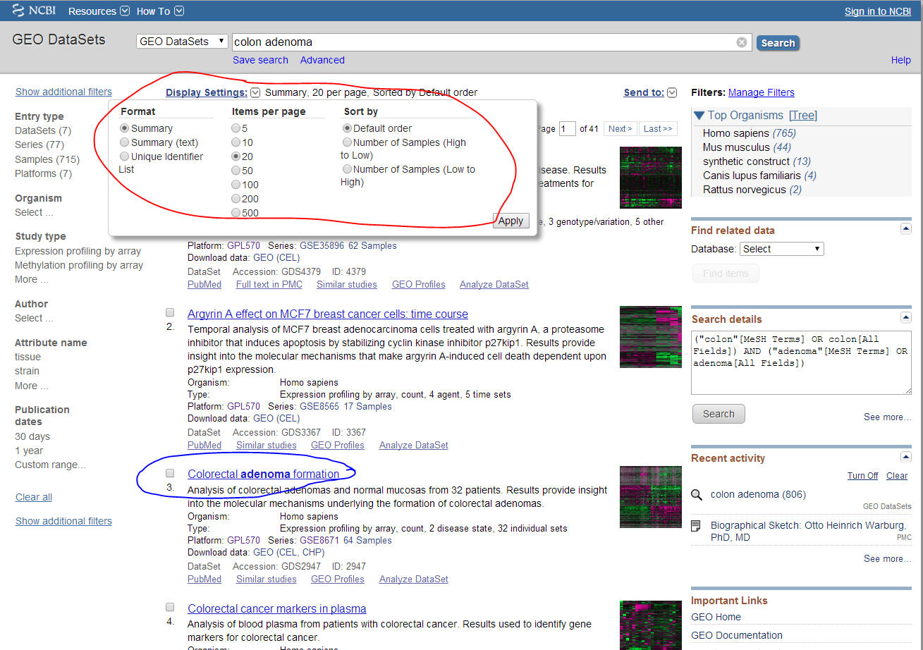
Step 3: Go to the data page

Slide 8
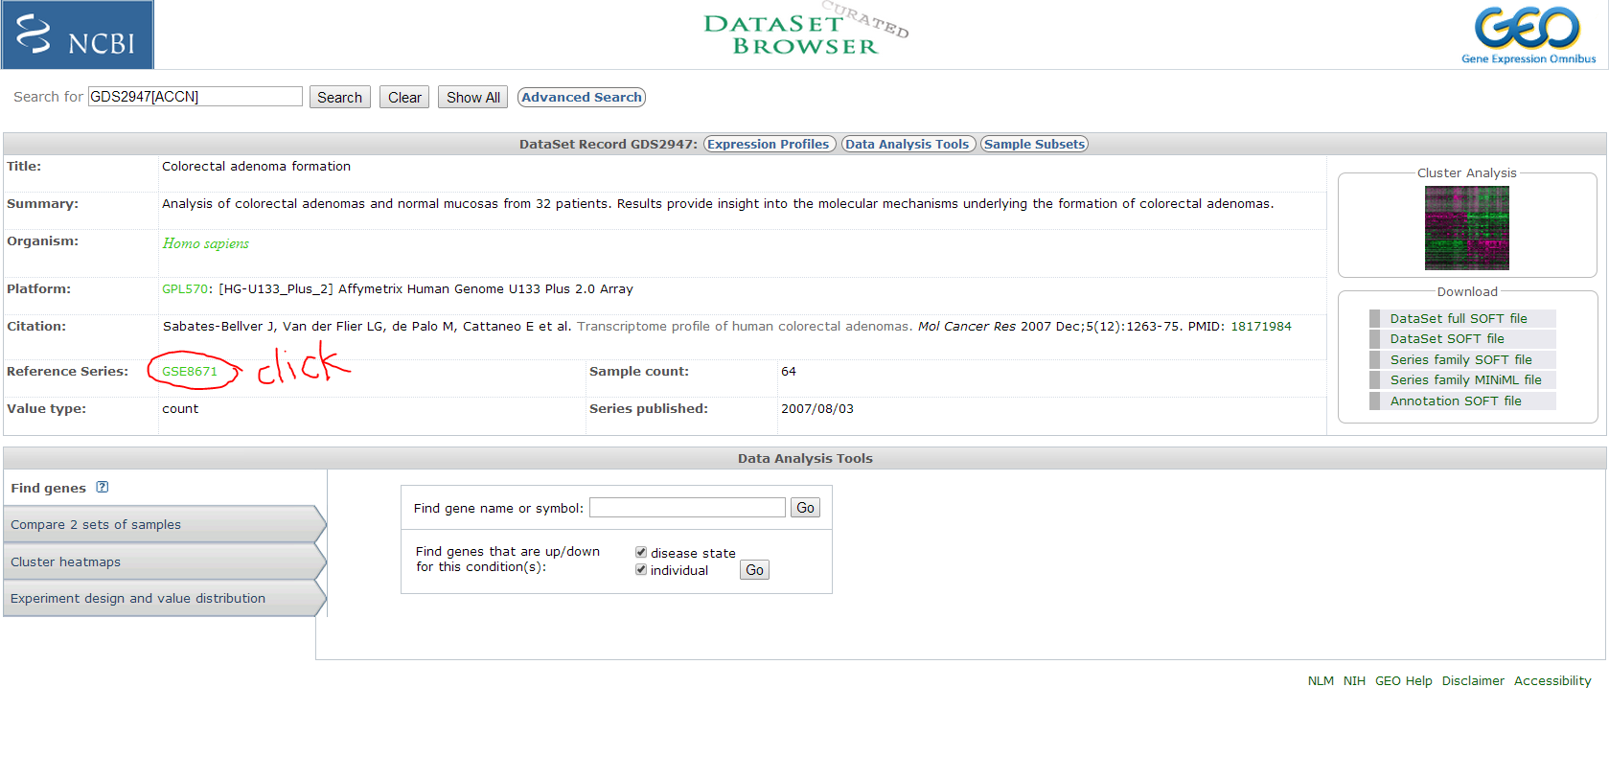
Step 3: Go to the data page

Slide 9
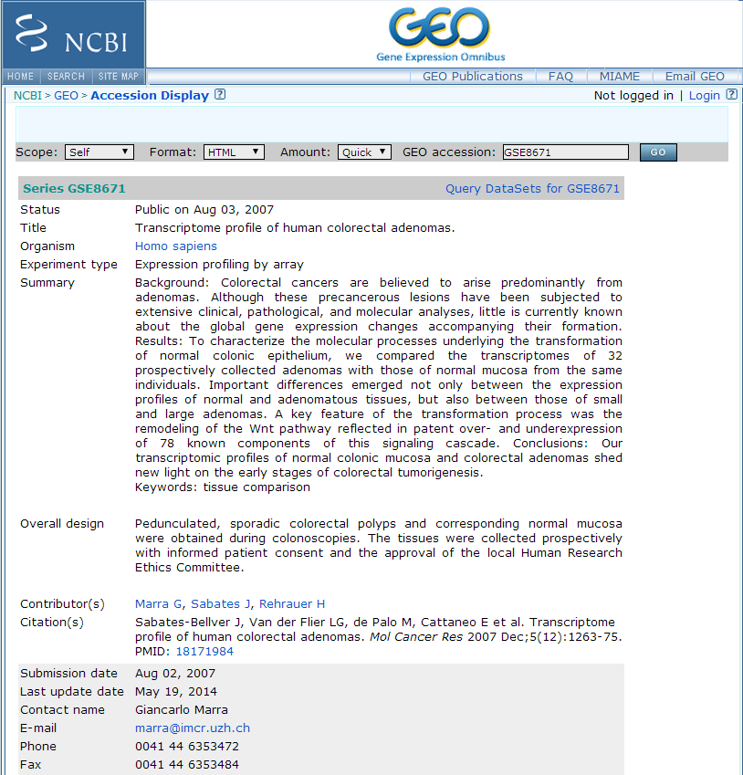
Step 3: Go to the data page
A link like
http://www.ncbi.nlm.nih.gov/geo/query/acc.cgi?acc=GSE8671

Slide 10
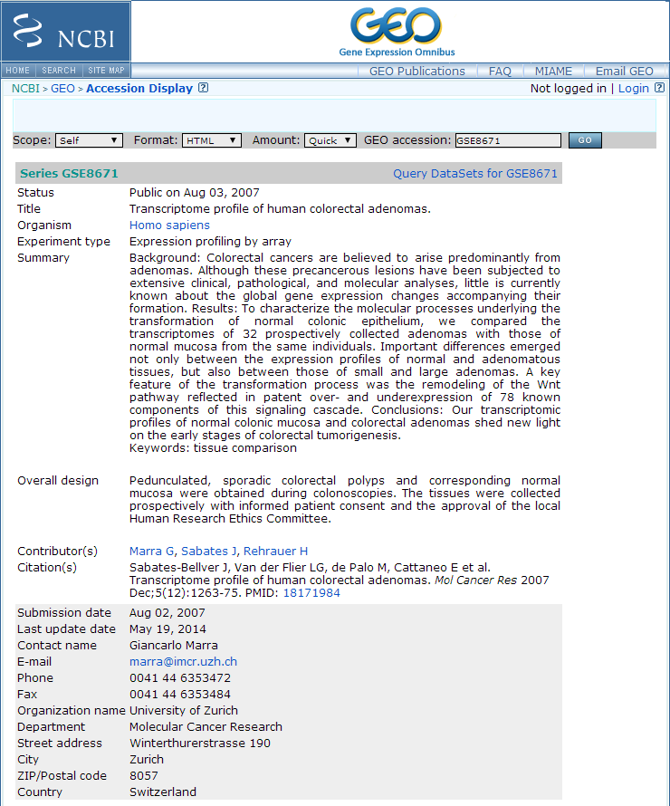
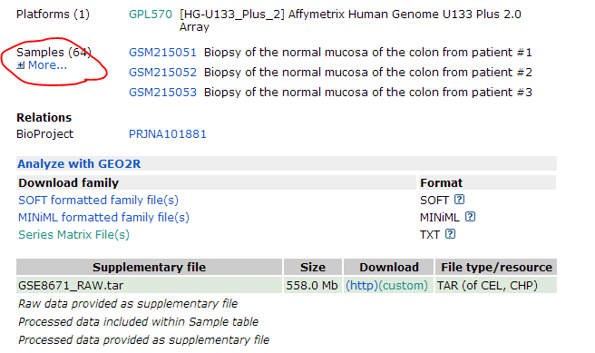
Meta data, description of the data and the data file

Slide 11
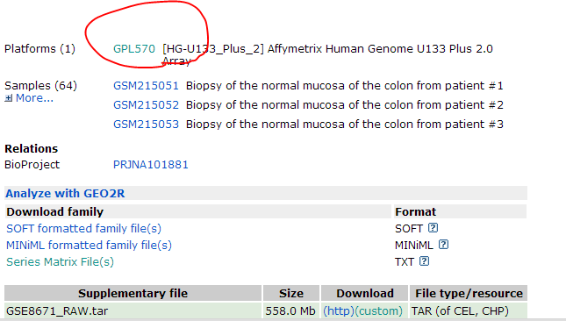
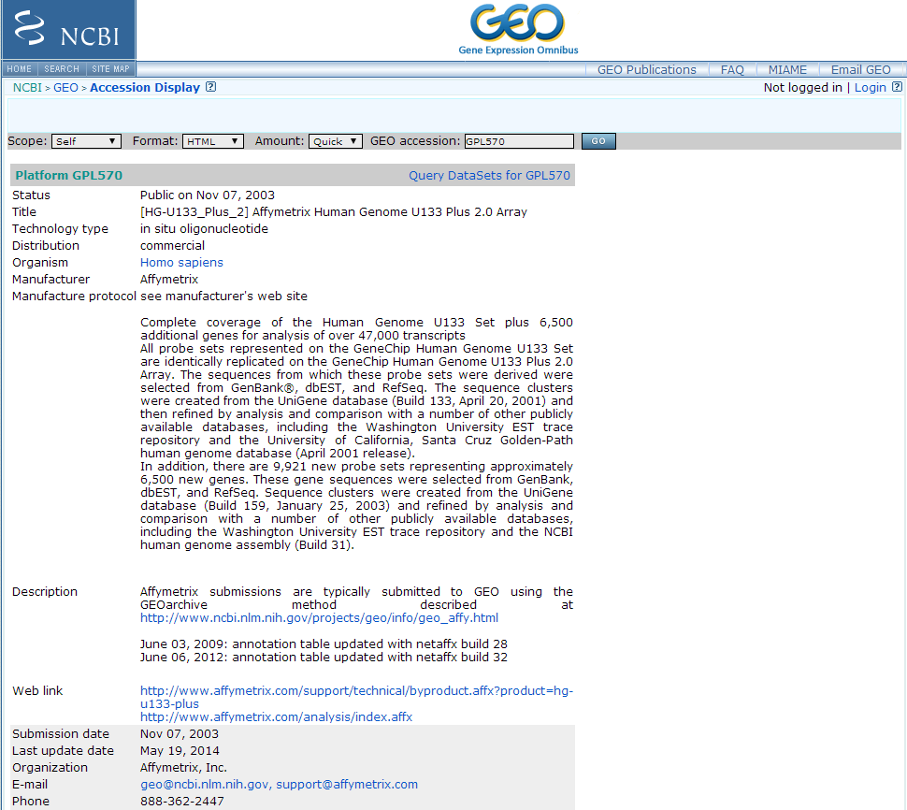
Platform
http://www.ncbi.nlm.nih.gov/geo/query/acc.cgi?acc=GPL570

Slide 12
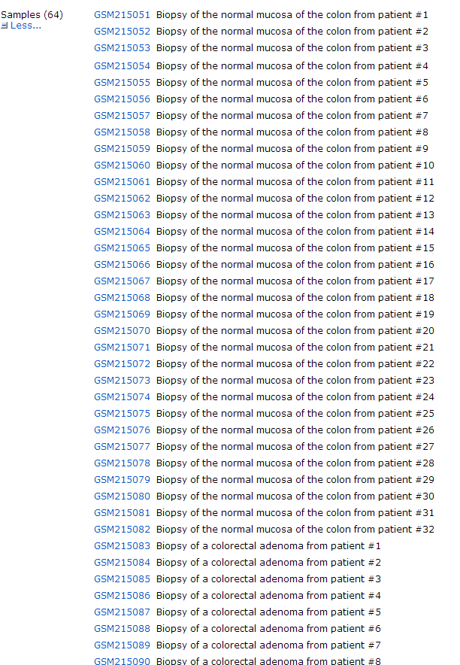
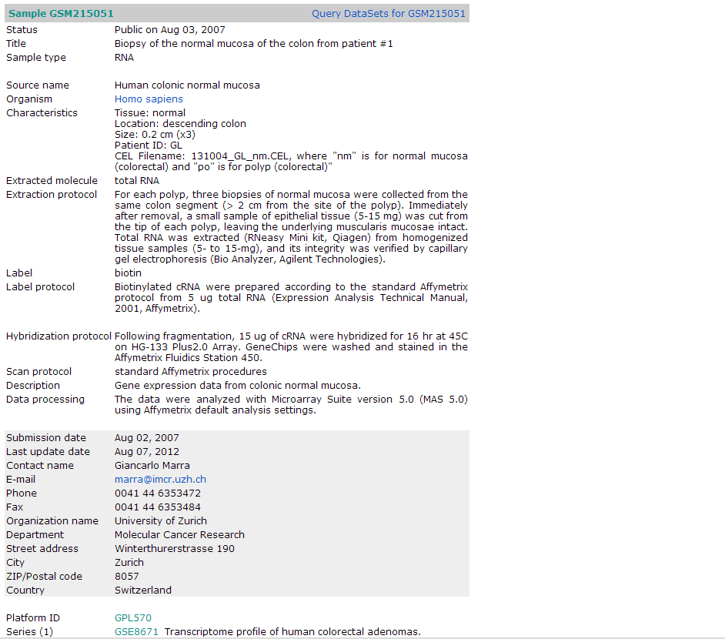
Samples

Slide 13
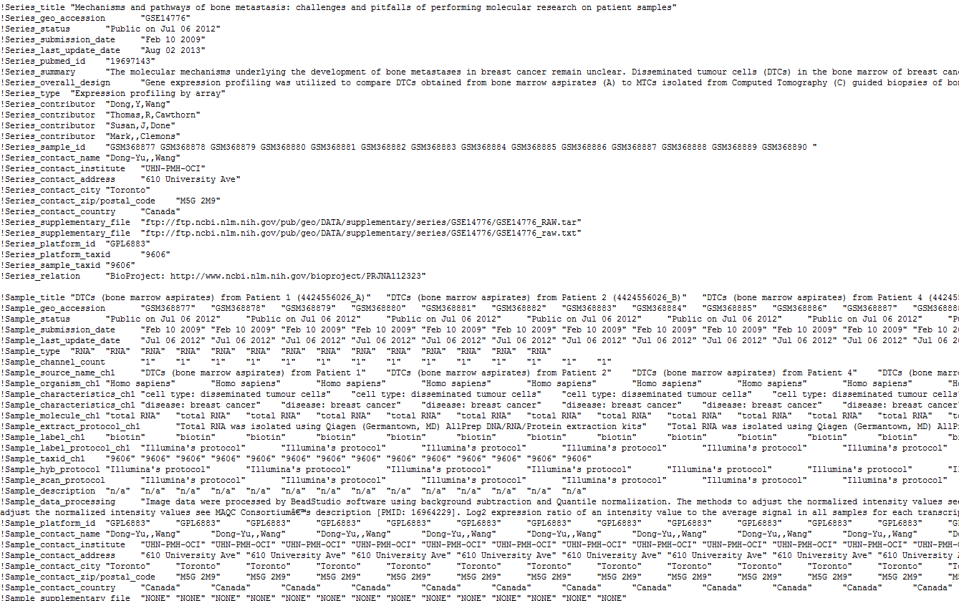
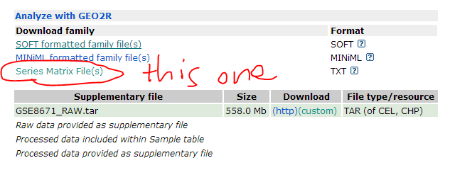
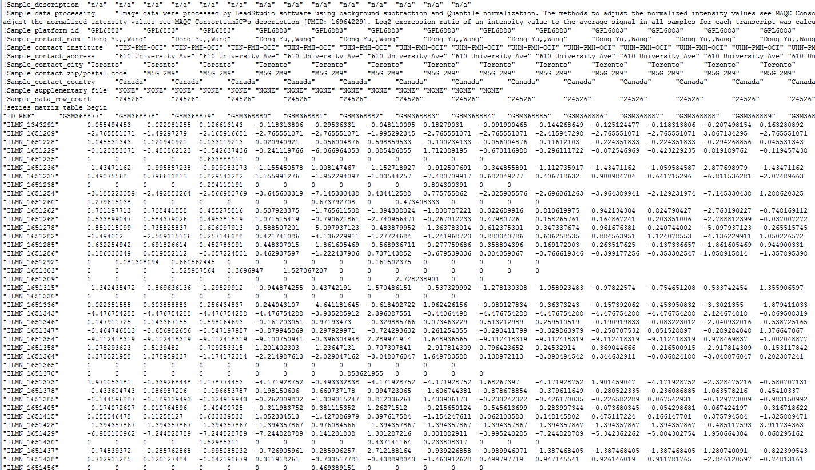
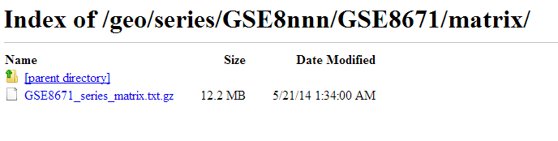
data

